Slide 1
THE DAY MILLENNIALS MANAGE THE TECHNICAL WORKFORCE
How shit’s gonna look. Now pass me my avocado toast.

Slide 2
WORKFORCE GENERATIONS
BOOMERS
GEN X
Born from 1946-1964
Born from 1965-1980
MILLENNIALS
GEN Z
Born from 1981-1996
Born from 1997-2012

Slide 3
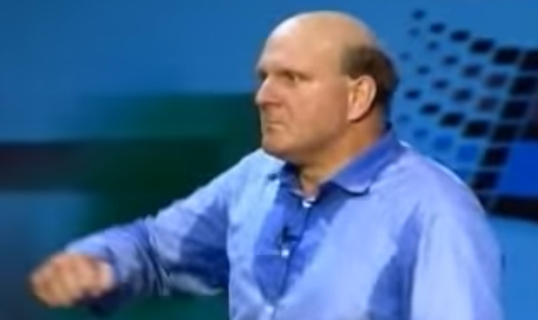
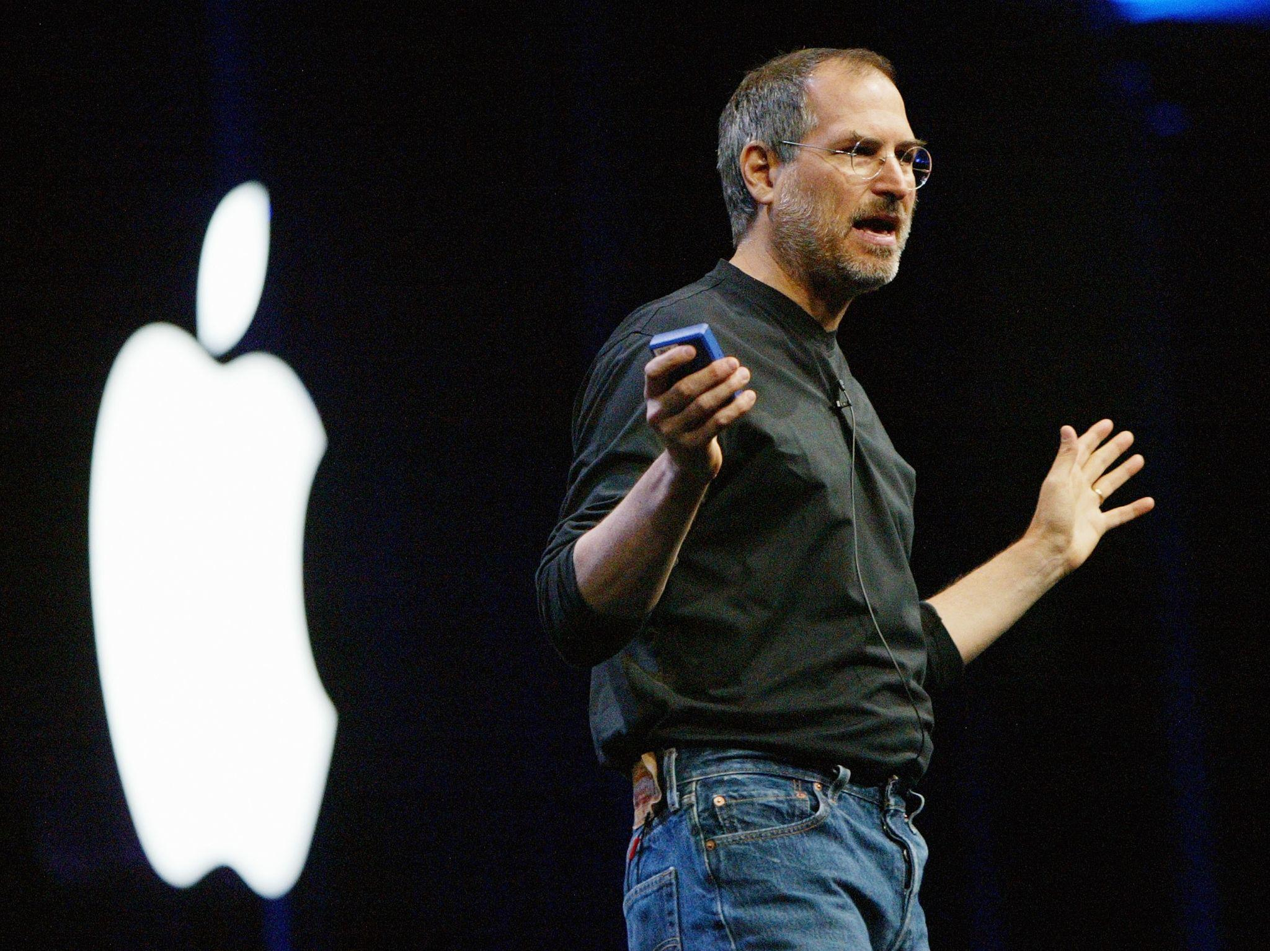

BOOMERS HAVE DOMINATED TECH LEADERSHIP FOR MOST OF OUR LIFETIME

Slide 4
WHO COULD FORGET THIS MOTIVATING EMAIL FROM MARCH 13, 2001?
“We are getting less than 40 hours of work from a large number of our KC-based EMPLOYEES. The parking lot is sparsely used at 8 a.m.; likewise at 5 p.m. As managers, you either do not know what your EMPLOYEES are doing; or you do not CARE… You have created expectations on the work effort which allowed this to happen inside Cerner, creating a very unhealthy environment. In either case, you have a problem and you will fix it or I will replace you. NEVER in my career have I allowed a team which worked for me to think they had a 40 hour job. I have allowed YOU to create a culture which is permitting this. NO LONGER.… Hell will freeze over before this CEO implements another employee benefit in this culture… I am tabling the promotions until I am convinced that the ones being promoted are the solution, not the problem. If you are the problem, pack your bags… I am giving you two weeks to fix this. My measurement will be the parking lot. It should be substantially full at 7:30 a.m. and 6:30 p.m. The pizza man should show up at 7:30 p.m. to feed the starving teams working late… You have two weeks. Tick-tock.”

Slide 5
WHO COULD FORGET THIS MOTIVATING EMAIL FROM MARCH 13, 2001?
“We are getting less than 40 hours of work from a large number of our KC-based EMPLOYEES. The parking lot is sparsely used at 8 a.m.; likewise at 5 p.m. As managers, you either do not know what your EMPLOYEES are doing; or you do not CARE… You have created expectations on the work effort which allowed this to happen inside Cerner, creating a very unhealthy environment. In either case, you have a problem and you will fix it or I will replace you. NEVER in my career have I allowed a team which worked for me to think they had a 40 hour job. I have allowed YOU to create a culture which is permitting this. NO LONGER.… Hell will freeze over before this CEO implements another employee benefit in this culture… I am tabling the promotions until I am convinced that the ones being promoted are the solution, not the problem. If you are the problem, pack your bags… I am giving you two weeks to fix this. My measurement will be the parking lot. It should be substantially full at 7:30 a.m. and 6:30 p.m. The pizza man should show up at 7:30 p.m. to feed the starving teams working late… You have two weeks. Tick-tock.”

Slide 6



Notes:
They’re not retiring yet. Not cause they don’t have to, but because they need something to fill the time between their trips to Florida and walking their small yappy dogs.

Slide 7


BUTKER APPROVED.

Slide 8
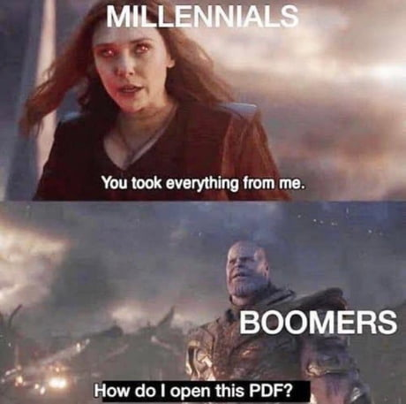

Slide 9

Gen X
<TEXT HERE>

Slide 10


01
MILLENNIAL TAKEOVER
Notes:
We’ve realized that maybe promoting the best engineers to be managers ISNT the best strategy after all

Slide 11
MILLENNIAL LED POLICIES
BETTER PARENTAL LEAVE
MENTAL HEALTH RESOURCES
PAID PET INSURANCE
Millennials will probably be the last generator to procreate (except for generations living in Texas)
Global warming, soaring interest rates, housing crisis, we know you’re gonna need it.
Still cheaper than having kids.

Slide 12
Work-Life Balance
Won’t Force RTO Orders
Different Job Descriptions
We’ll advocate for it, but also still check Slack more than we should
We know it’s easier to be productive while crying from the privacy of your own home.
We know a 🚩when we see one

Slide 13
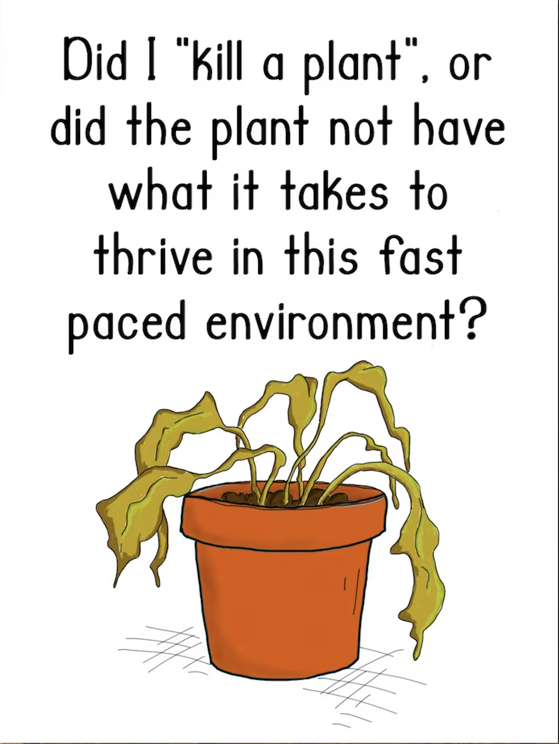

Slide 14
BAD NEWS
We’re the Digital Generation, which means …

Slide 15

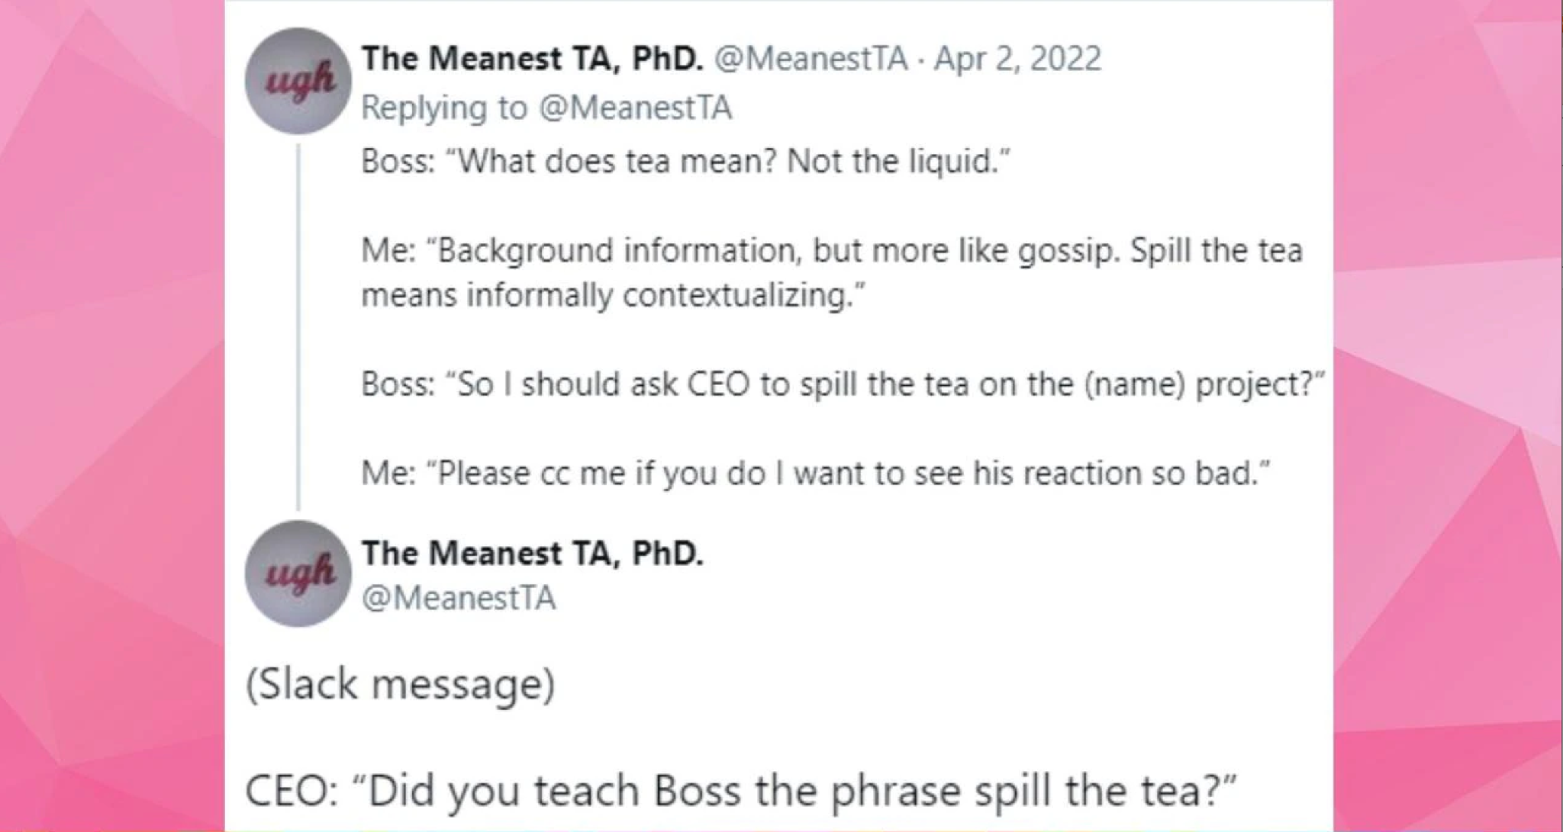

Slide 16
LMFGTFY
millennials

Slide 17
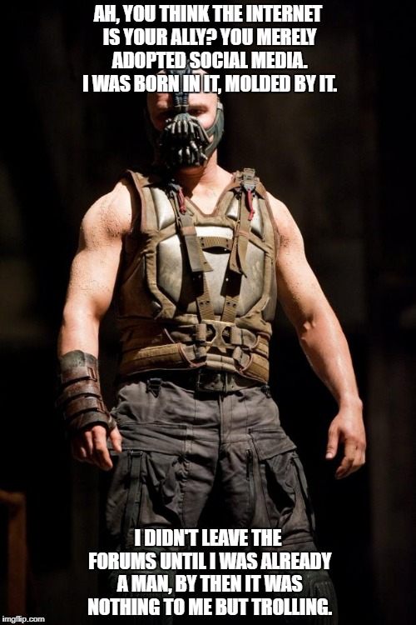

Slide 18
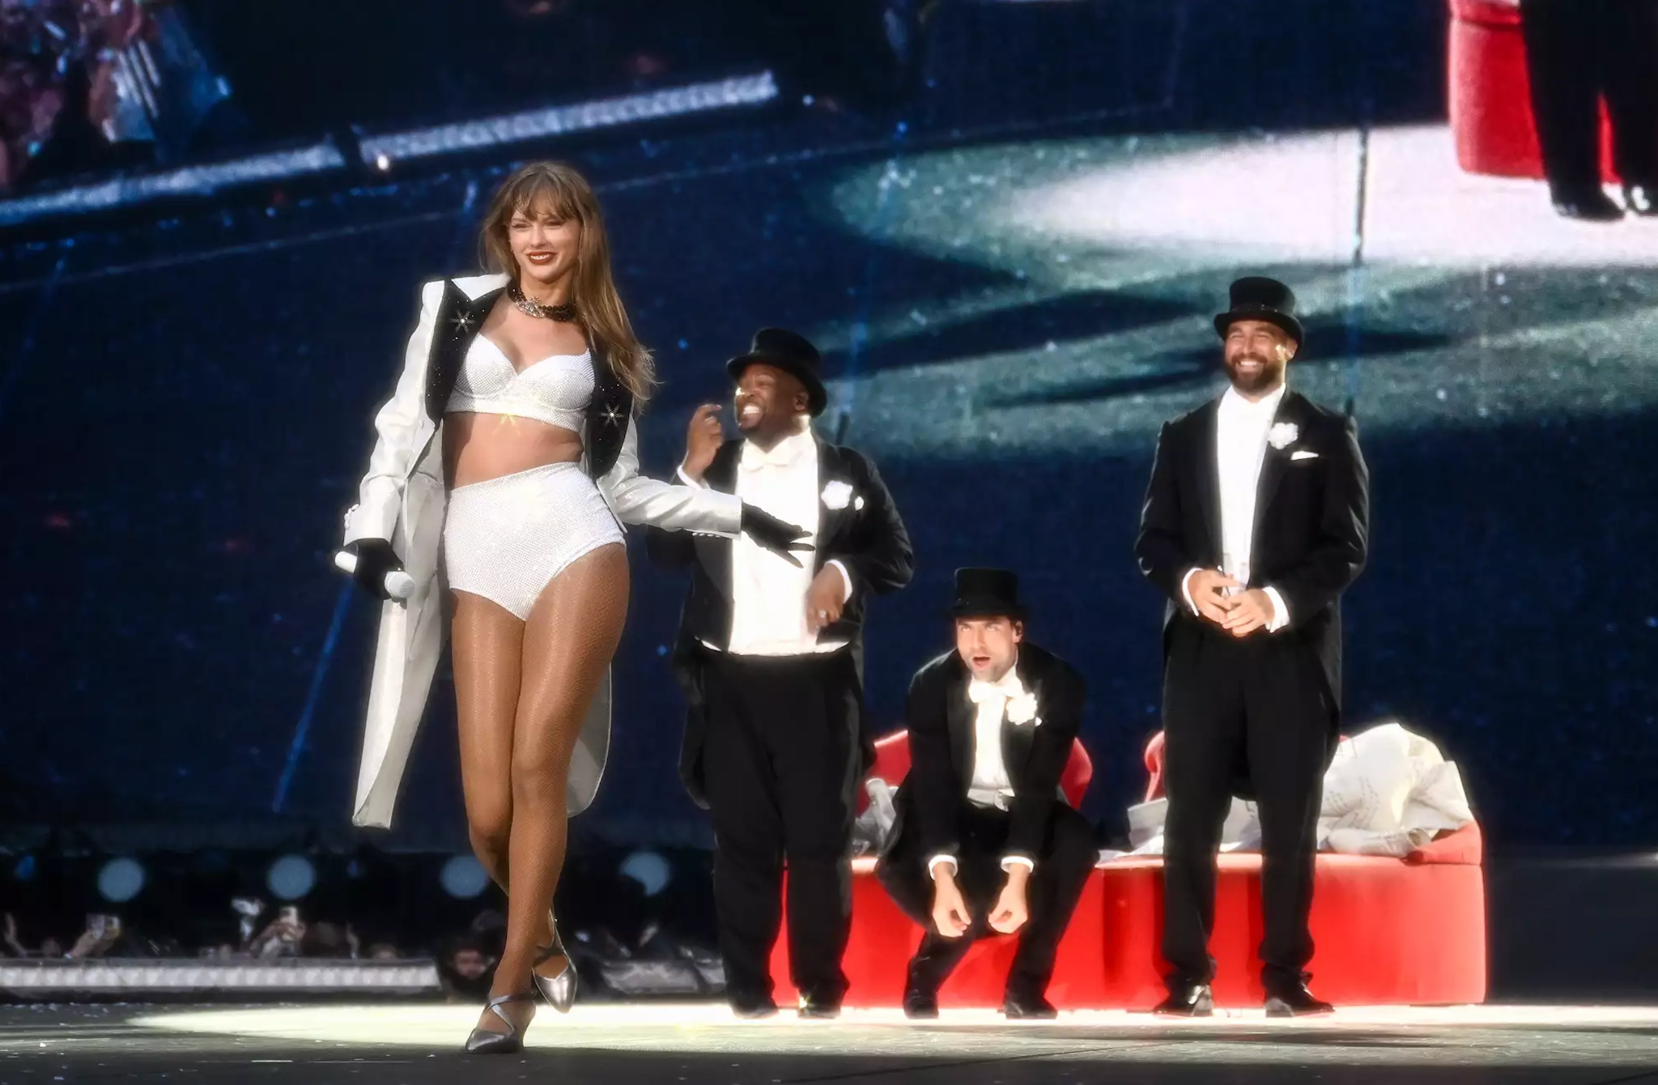

Slide 19
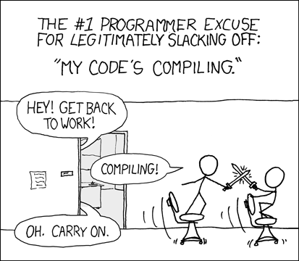

Slide 20




NOPE

